Slide 1


Novy Mart Analysis

Slide 2
Problem Statement.
Novy Mart is a retail giant with over 50 supermarkets in the southern region of India. All their 50 stores ran a massive promotion during the Diwali 2023 and Sankranti 2024 (festive time of India) on their Novy branded products. Now the sales director wants to understand which promotions did well and which did not so that they can make informed decisions for their next promotional period.

Slide 3

Provide a list of products with a base price greater than 500 and that are featured in promo type of ‘BOGOF’ (Buy One Get One Free). This information will help us identify high-value products that are currently being heavily discounted, which can be useful for evaluating our pricing and promotion strategies.
Novy Double Bedsheet Set and Novy Waterproof Immersion Rod, these are the two products where base price is greater than 500 and promo type is ‘BOGOF’ (Buy One Get One Free.).

Slide 4
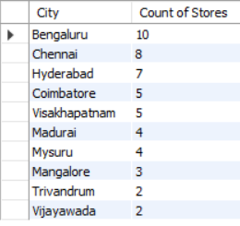
Generate a report that provides an overview of the number of stores in each city. The result will be sorted in descending order of store counts, allowing us to identify the cities with the highest store presence.
Bengaluru has the highest no of stores which is 10.
Followed by Chennai which has the second highest no of stores which is 8.
Followed by Hyderabad which has the second highest no of stores which is 7.
And the remaining Cities which are Coimbatore, Visakhapatnam, Madurai, Mysuru, Mangalore, Trivandrum and Vijayawada come between 2 and 5 in terms of no of stores.

Slide 5

Generate a report that displays each campaign along with the total revenue generated before and after the campaign ? The report includes three fields: Campaign Name, Total Revenue (Before Promotion), Total Revenue (After Promotion). This report should help in evaluating the financial impact of our promotional campaigns. (Display the values in millions).
In Diwali Campaign, Novy Mart has generated total revenue of 82.57 M before promotion while 207.46 M after the promotion meaning a significant increase 152% in revenue.
In Sankranti Campaign, Novy Mart has generated total revenue of 58.13 M before the promotion while 140.40 M after the promotion meaning a significant increase 141% in revenue.

Slide 6
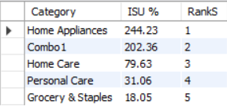
Produce a report that calculates the incremental sold quantity (ISU %) for each category during the Diwali campaign. Additionally, provide rankings for the category based on their ISU %. The report will include three key fields: Category, ISU%, Rank Order.
In Category Home Appliances has contributed the highest ISU % i.e. 244.23 %.
Followed by Combo1 which has contributed the second highest i.e. 202.36 %.
Followed by Home Care Category which comes 3rd i.e. 79.63 %.
Followed by Personal Care which comes 4th i.e. 31.06 %.
And Grocery & Staples which comes 5th which is 18.05 %.

Slide 7
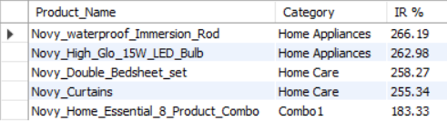
Create a report featuring the Top 5 Products, ranked by Incremental Revenue Percentage (IRP %), across all campaigns. The report will provide essential information including Product Name, Category, IR %.

Slide 8
Thank You !

